Slide 1
Haldimand County Fire
JR Fire Fighter Program
JR Fire Fighter Program

Slide 2
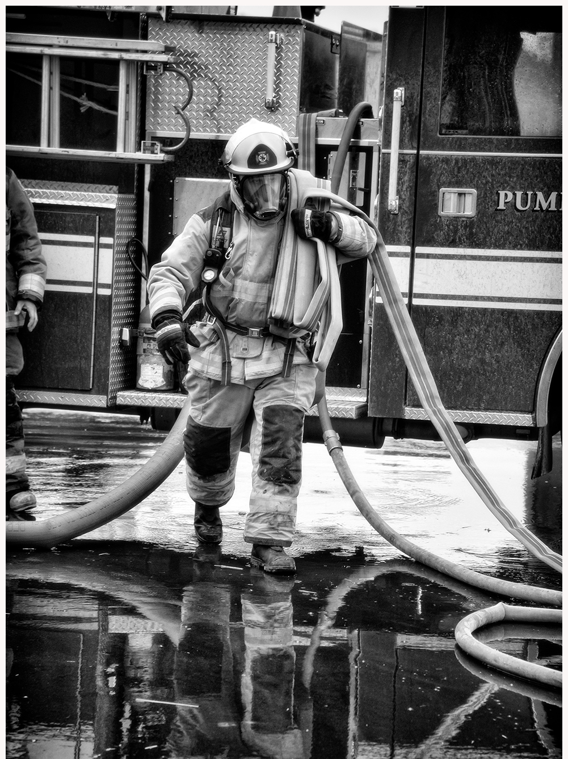
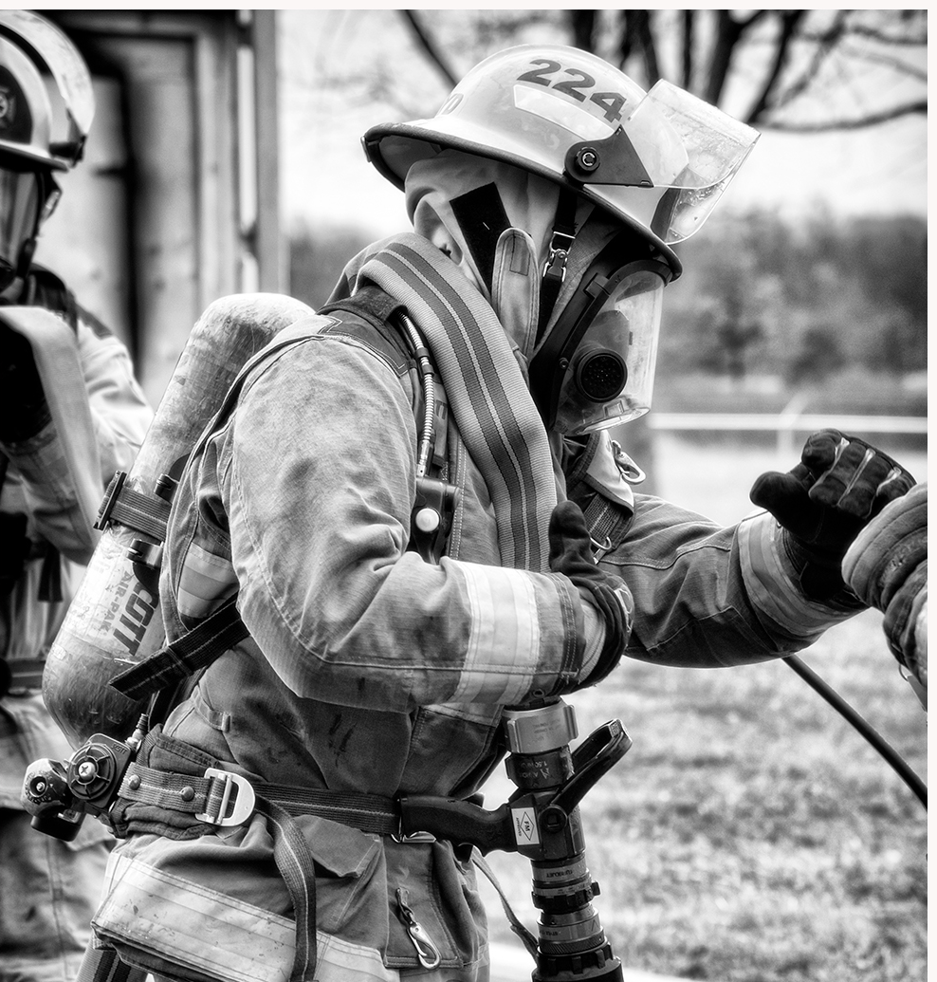
Introductions
Notes:
Manager of Emergency Services / Fire Chief Jason Gallagher
Deputy Fire Chief Rodger Hill
Training and Health & Safety Coordinator Bryan Edge
Fire Prevention Officer Al Gee
Fire prevention officer Richard Geerdink
Administrative Assistant Barb Lomnicki

Slide 3
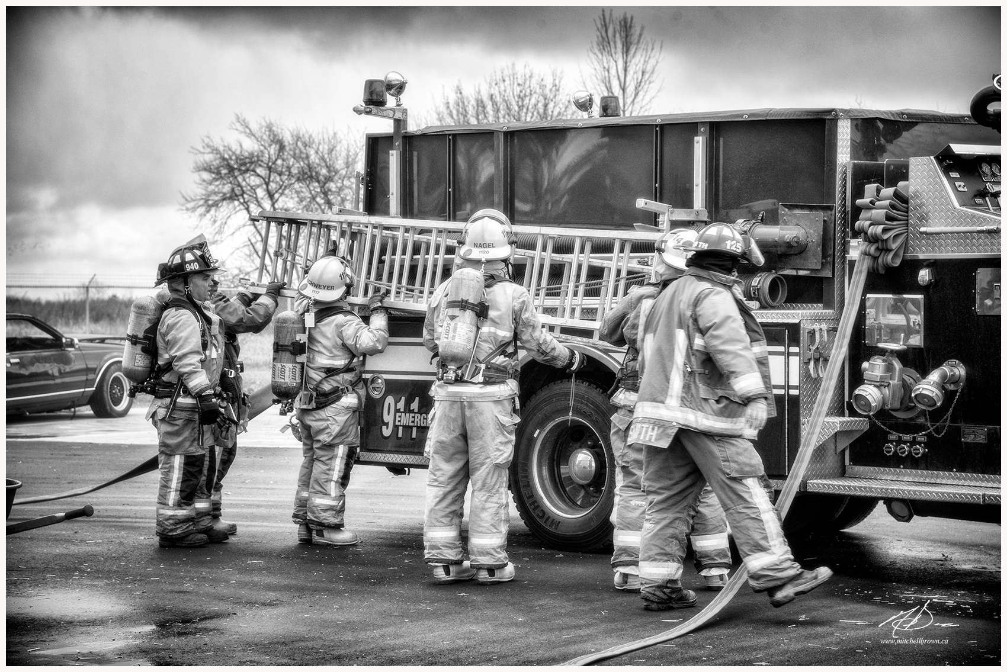
The Haldimand County Fire Department
Notes:
What Makes up The Haldimand County Fire Department?
Part of the Emergency Services Division
Also includes Haldimand County Paramedic Services & the Haldimand County Emergency Management Program
11 Fire Stations
37 Fire Trucks, 5 staff vehicles & 4 boats
274 Firefighters
Can anyone guess how many calls HCFD responds to every year?
Approximately 1000 calls per year

Slide 4
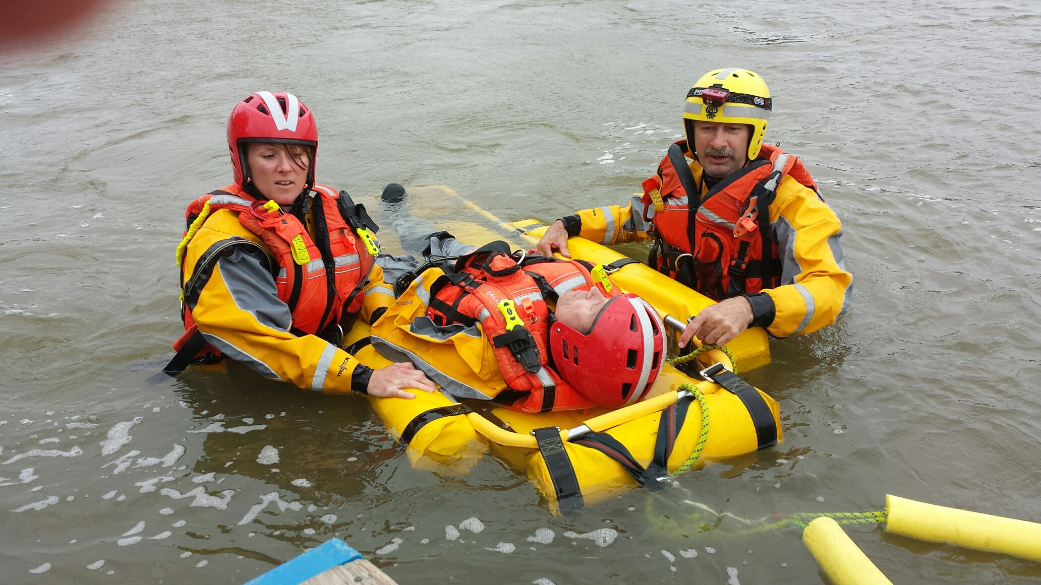
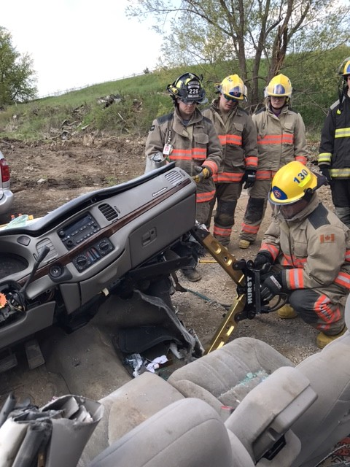
The Haldimand County Fire Department
Notes:
What are some types of calls that HCFD respond to each year?
Structure fires
Vehicle fires
Grass/brush fires
Motor vehicle accidents
Emergency medical assistance calls
Water/ice rescues
Public assistance calls

Slide 6
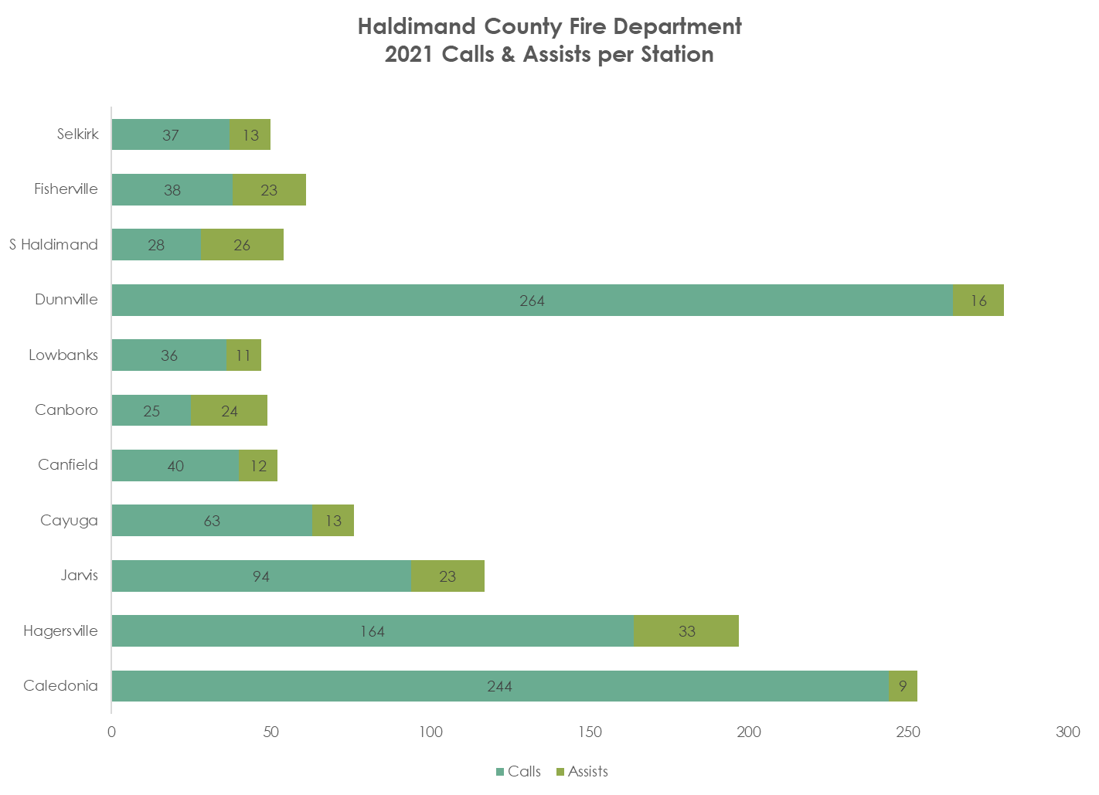

Slide 7
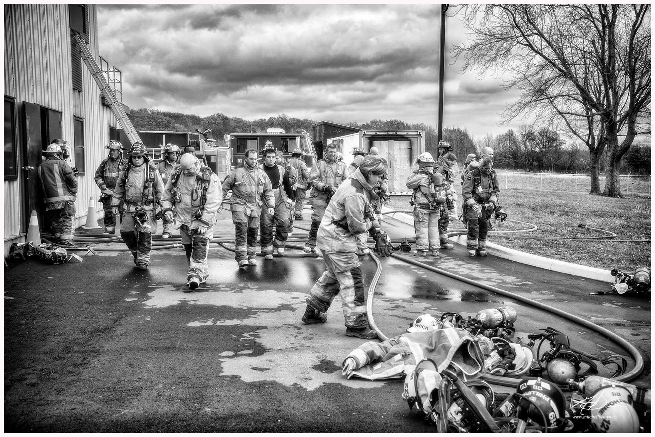
Haldimand County Fire Department Makeup
Notes:
Department Composition:
1 career Chief
1 career Deputy Chief
2 career Fire Prevention Officers
1 career Training and Health & Safety Coordinator
220 volunteer Firefighters
48 volunteer Captains
11 volunteer District Chiefs
Our Fire Department relies on volunteer firefighters & officers to effectively manage emergency incidents & to successfully manage all other aspects of the department.

Slide 8
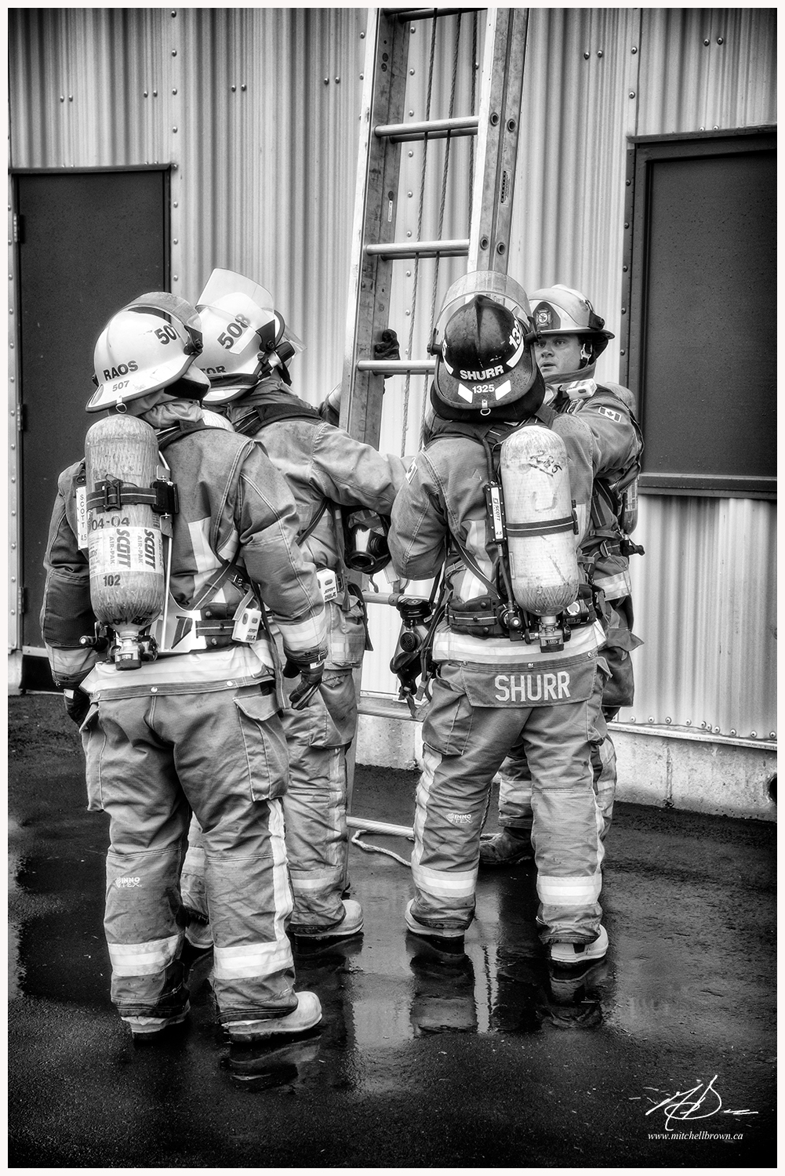
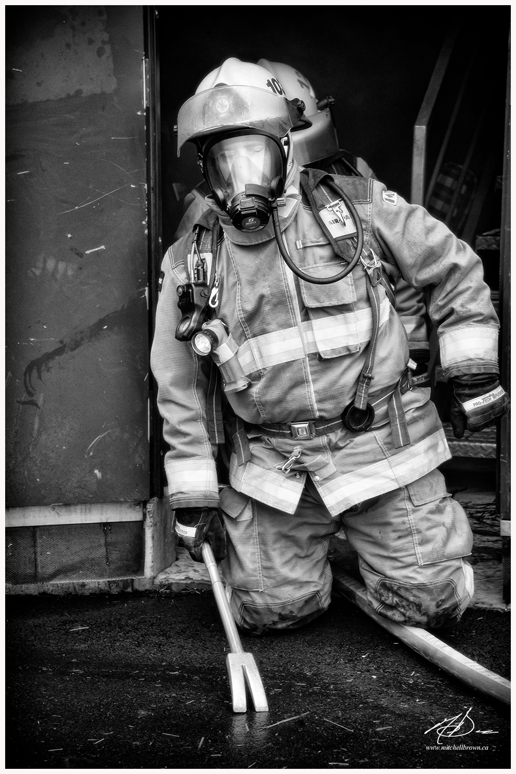
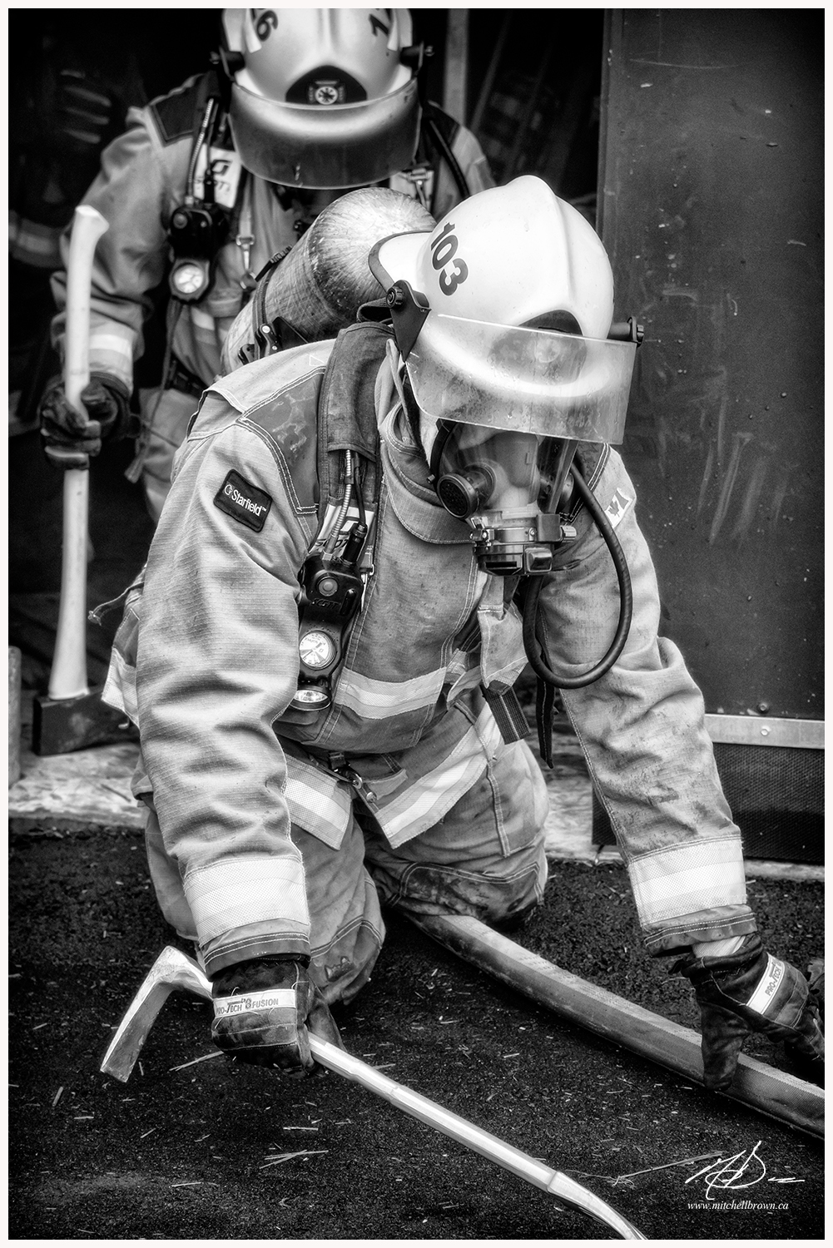
JR Fire Fighter Program
Notes:
What is the JR Fire Fighter Program?
The Haldimand County Fire Department Junior Firefighter Program allows students the ability to gain volunteer hours required for graduation by volunteering at fire stations within their community, by observing and participating in station duties as well as firefighter training.
Each Station in Haldimand County will determine how many students they can safely manage with no more then 3 per station.
Each Student will be trained in firefighting skills, however no live fire participation will be allowed.
Students will be assigned to a mentor who will be responsible for the student while at the station and responsible for all documentation required to track the students hours. In the absence of the mentor a senior firefighter must be assigned to the student by the mentor or the student cannot participate in the training night.
Each student will receive training in First Aid/CPR at the Health Care Provider Level.
Each student will be provided with firefighter PPE to use during the duration of their assignment, and all PPE must be returned following completion of the program or early dismissal.
Each Student will be given 1 blue T-Shirt, identifying them as a junior firefighter and can only be worn while at the fire station. Student will be allowed to keep the T-Shirt following their assignment

Slide 9
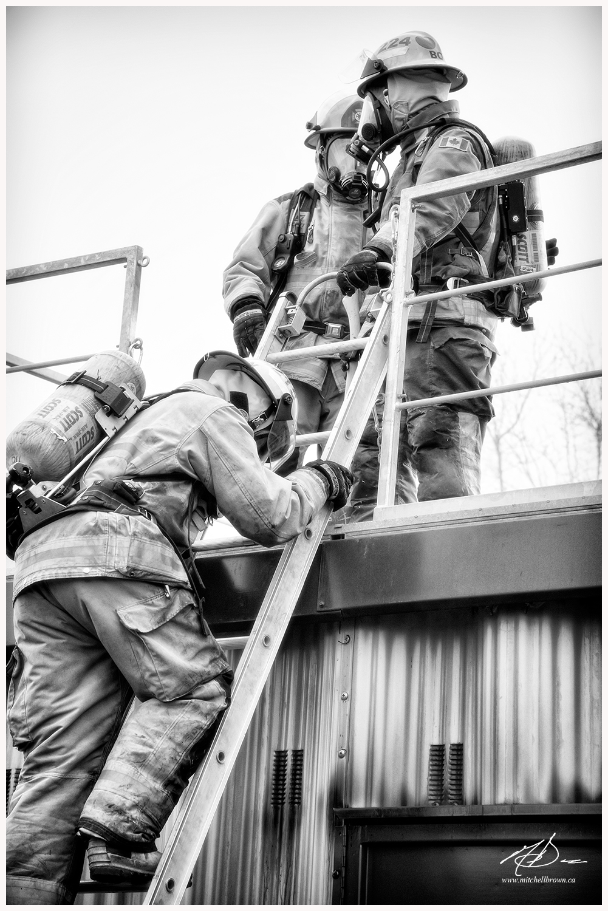
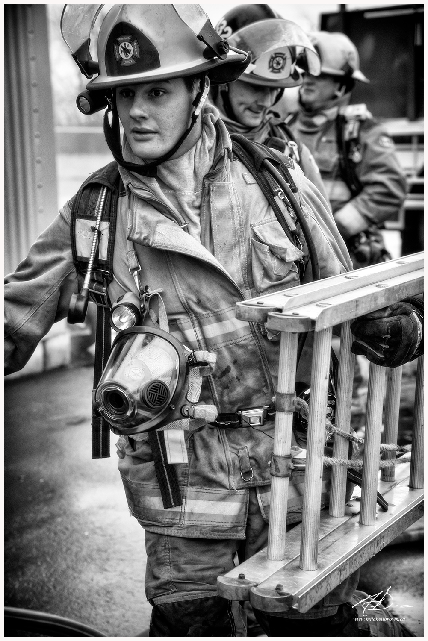
JR Fire Fighter Program Expectations
Notes:
What are the Expectations?
Each Student must provide their own safety footwear. CSA Approved steel toed boots, black in color.
Students must act respectful and professional at all times when representing the Haldimand County Fire Department (can be dismissed at any time- discretion of the Fire Chief)
What are some good attributes that JR Fire fighters need to be successful?
Good attitude
Good Work ethic
Willingness to learn and adapt
Patience
Physical fitness
Empathy
Reliability and trustworthiness

Slide 10
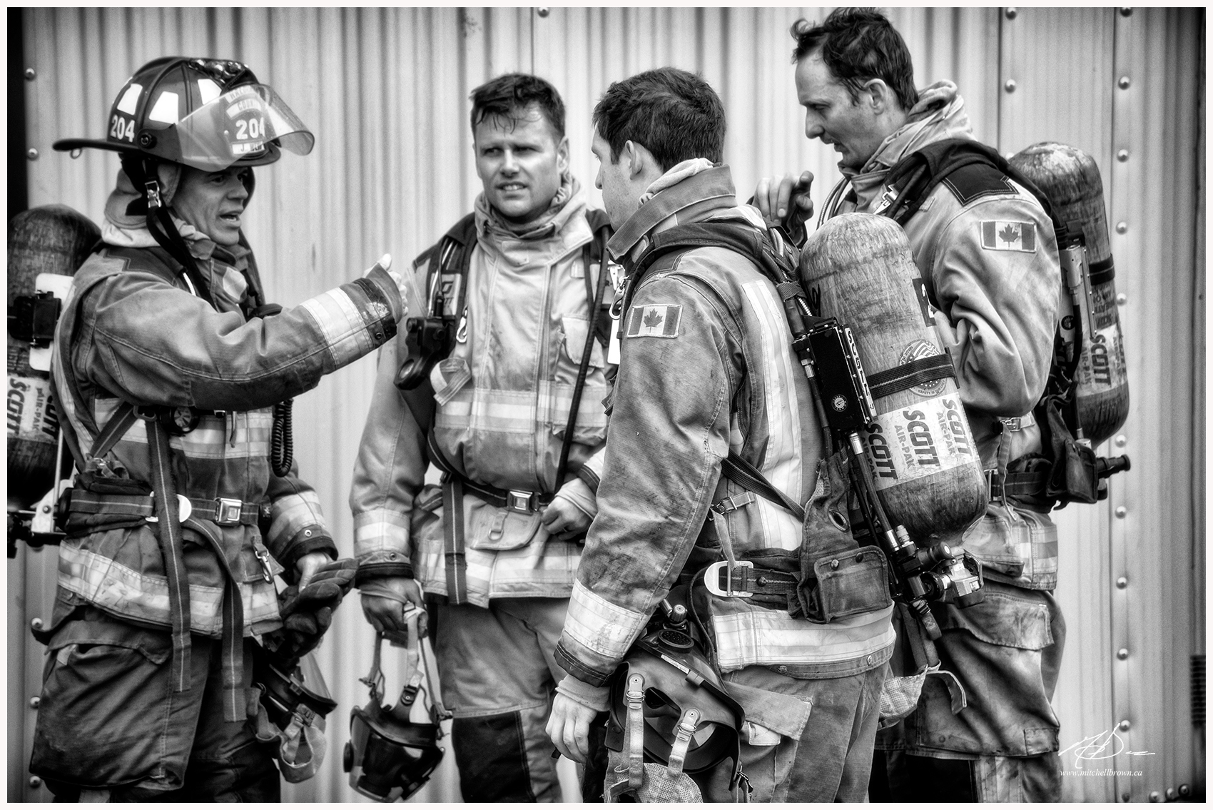
JR Fire Fighter Mentor
Notes:
Who will look after the JR Fire Fighters?
The student will have a mentor that is willing to take on the responsibility for the student.
The mentor will be directly responsible for the safety and records management regarding the student while he/she is volunteering his/her hours with the fire department.

Slide 11
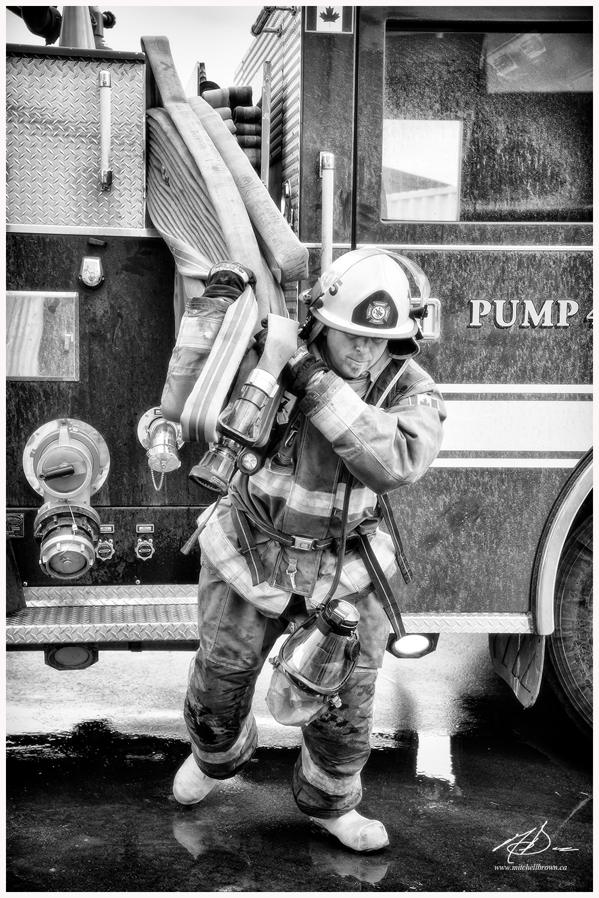
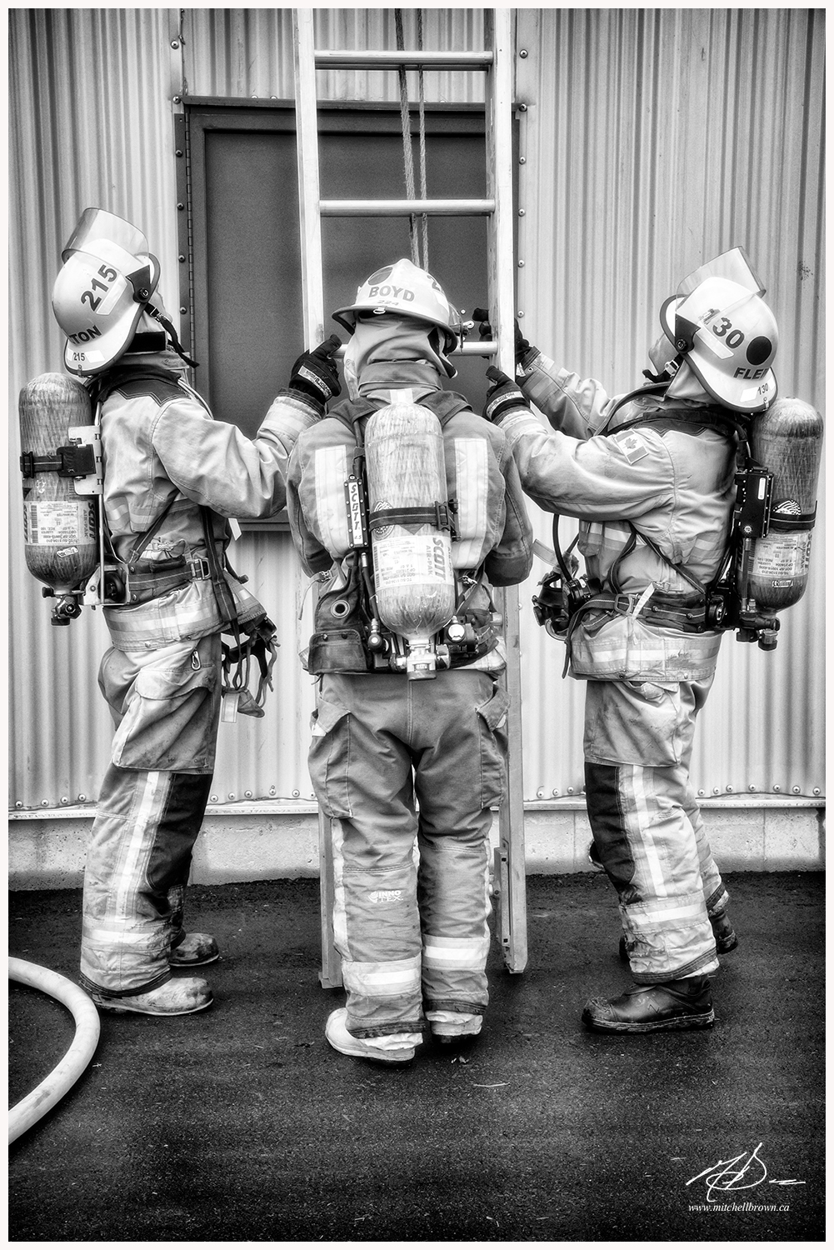
Training & Duties
Notes:
What will the JR Fire Fighters be doing?
Participate in fire department activities
Participate in weekly Training sessions (no live fire)
Participate in weekly equipment/station inspections, maintenance, meetings
Each station meets once a week. The evenings each station meets are listed below.
Mondays : Caledonia, Hagersville, Jarvis, Cayuga, Canfield, Canboro, Dunnville, South Haldimand, Fisherville, Selkirk.
Wednesdays: Lowbanks
Participate in weekly sessions are used for training, equipment/station inspections, maintenance, meetings and other activities

Slide 12
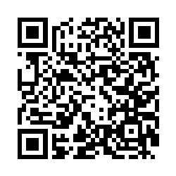
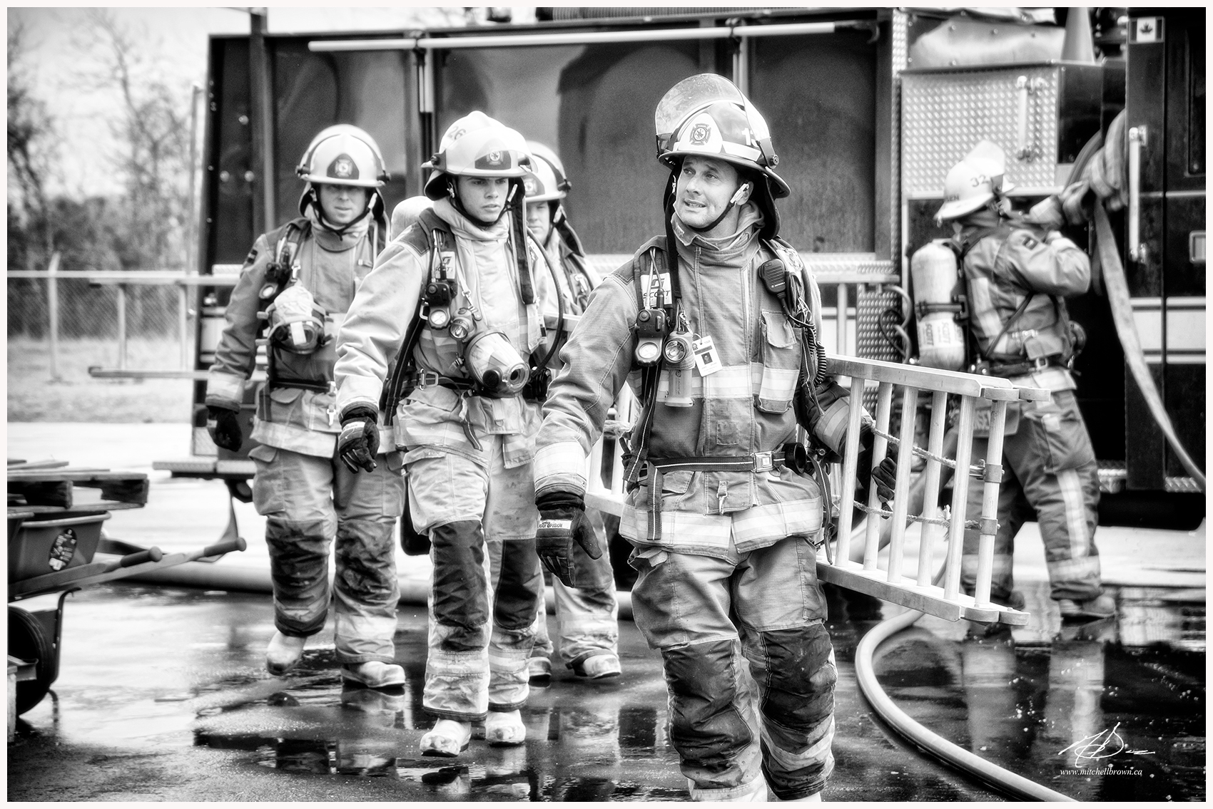
Scan the QR code to for more info to join
Notes:
For more information check the website at www.haldimandcounty.ca click on the emergency services section or follow us on Twitter & INSTAGRAM @haldemerg
For questions regarding the process please contact Barb lomnicki at 905-318-5932 Ext. 6224

